Slide 1
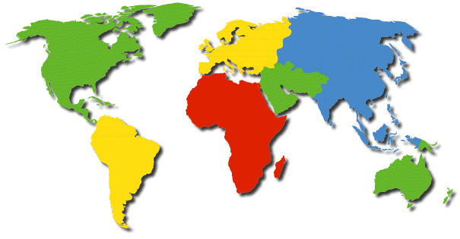
What is culture?

Slide 2

Culture is like a rainbow

Slide 3
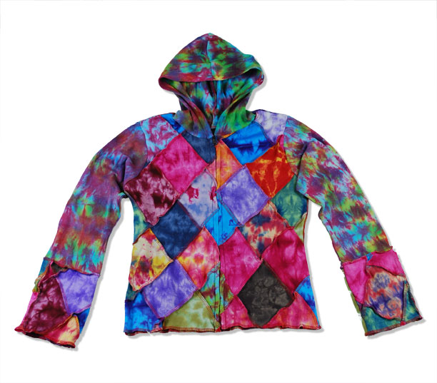
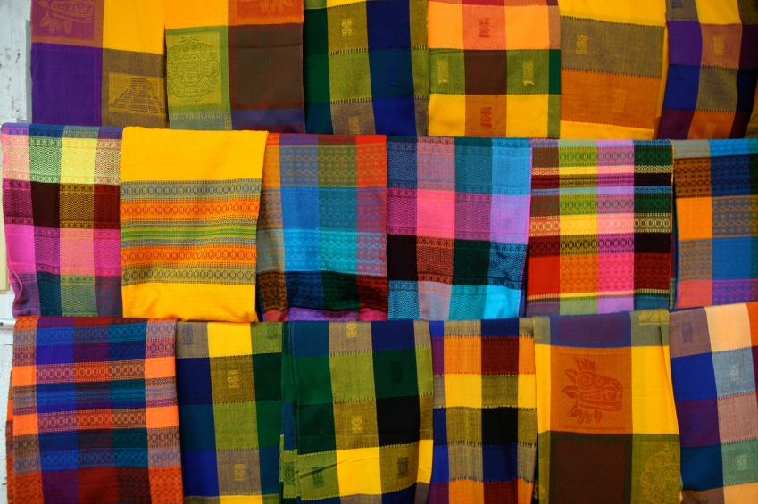
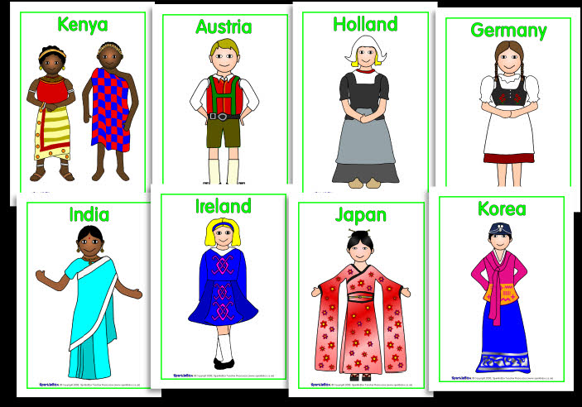
Clothing

Slide 4

Religion – Believes

Slide 5




Climate

Slide 6
Shelter – Housing

Slide 7
A r t

Slide 8




M u s i c

Slide 9


Education

Slide 10
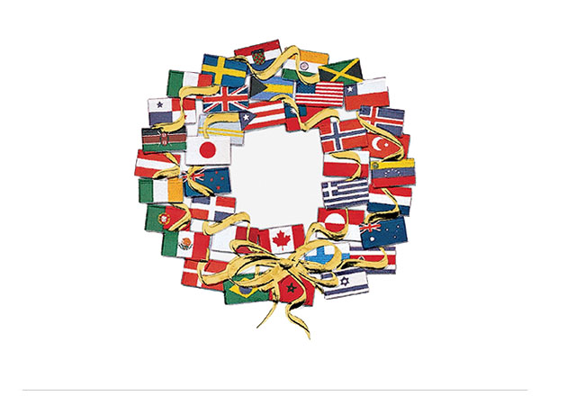
Festivities

Slide 11
F O O D

Slide 12

Children

